Slide 1
Development of an android based text detection application for visually impaired
Under the guidance of Prof. U.S Tiwary.

Slide 2
Team members
1. Gaurav Kumar Chandel (IIT2012056)
2. Nithin Srikar Karnala (IIT2012014)
3. Ritesh Kumar Sinha (IIT2012003)
4. Mohit Purbey (IIT2012055)
5. Harivansh Kumar (IIT2012026)

Slide 3
Abstract
We are going to develop an android based application which can be used by the visually impaired people. In short our application processes the image of the text which user wants to read and reads it aloud so that the user will be able to get the content of that text in the form of audio. We are developing our software on android platform for enhanced mobility by keeping in mind the recent trend of usage on the go. We are considering that the text to be read will be in English (US) and the TTS engine will read it aloud in English.

Slide 4
Motivation
The key motivation of this project is to help the visually impaired people and make their lives better by providing them a user friendly (precisely easy to use, targeting visually impaired) application which helps them in their day to day reading activities. As we all know it has become very easy these days to acquire a considerable android mobile and keeping that aspect in mind, we are targeting android platform.

Slide 5
Introduction
The application which we are going to develop includes preprocessing steps, then optical character recognition (OCR), then post processing steps and at last text to speech synthesis (TTS).
The preprocessing steps include
Converting the picture taken from camera to grayscale.
Canny edge detection
Deskewing of the image to align the text perfectly.
Binarisation.
Post processing steps include matching the words generated using English dictionary (lexicon).
We decided to first achieve a sub goal of recognizing a character (simple background) and then recognizing a word and in turn a paragraph (complex background).

Slide 6
Literature Review
OCR (Optical Character Recognition)
OCR can recognize both handwritten and printed text. But the performance of OCR is directly dependent on quality of input documents (Which we are enhancing using various preprocessing techniques). OCR is designed to process images that consist almost entirely of text, with very little non-text clutter obtained from a picture captured by a camera. The application which we are going to use is for the Android mobile operating system that combines Google’s open-source OCR engine, Tesseract, text recognition OCR engine. Tesseract is Open source OCR engine. It was firstly developed during 1984 to 1994 at HP. Finally in 2005, Tesseract was released as open source by HP and available at http://code.google.com/p/tesseract-ocr.

Slide 7
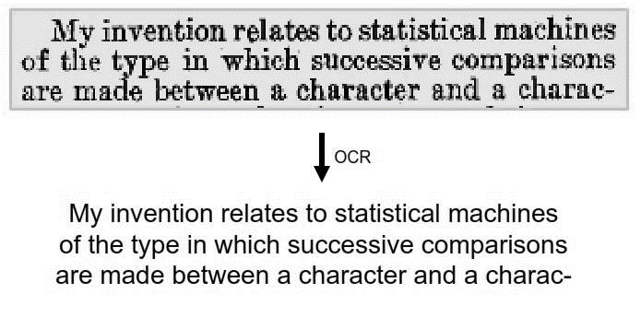
Fig. OCR Input and Output

Slide 8
TTS
A text to speech (TTS) synthesizer is a system that can read text aloud automatically upon feeding a text (which is extracted from Optical Character Recognition (OCR) and post processed in our case). A speech synthesizer can be implemented by both hardware and software. Speech synthesis is the artificial production of human speech. A computer system used for this purpose is called a speech synthesizer. A text-to-speech (TTS) system converts normal language text into speech. A synthesizer can incorporate a model of the vocal tract and other human voice characteristics to create a completely “synthetic” voice output.

Slide 9
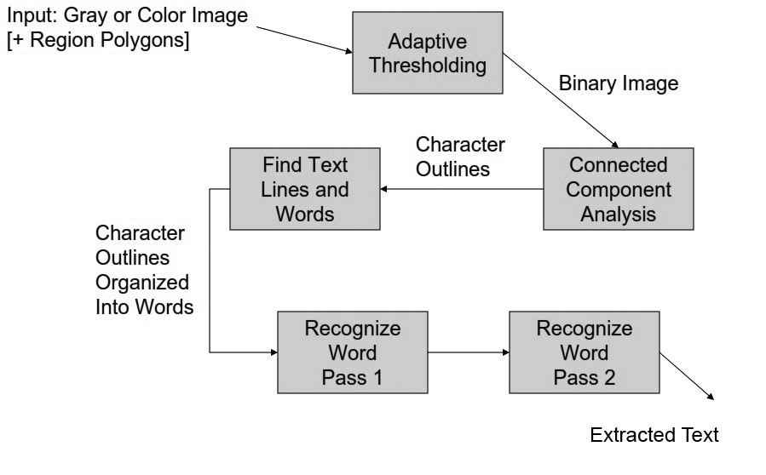
Fig. Tesseract Flow Diagram

Slide 10
Methods and Techniques used
Opening of the Application and initial steps:
We are going to design the application such that it can be opened by pressing some combination of hardware buttons for the ease of user. When the application is opened the user will be prompted to put the mobile in front of text to be read aloud (We are considering a constraint that he will put at a length of around 30cms i.e., arm’s length) and tap the screen when he/she is ready upon which a snap will be taken (We are considering that there will be optimum light for reading and text to be read will be completely within the captured image which can be said to be a constraint).
The application can even be opened easily by the visually impaired person with the help of inbuilt accessibility – Talk Back feature of android platform which works perfectly for opening other apps.

Slide 11
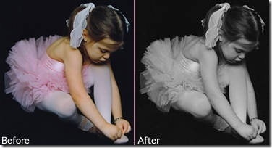
Methods and Techniques used
2. Preprocessing steps:
Various preprocessing steps which we are going to employ are as follows:
Convert the obtained image to Grey Scale
We will be using the weighted average of RGB as follows for each pixel
R = G = B = (0.299 * R + 0.587 * G + 0.114 * B)

Slide 12
Methods and Techniques used
2. Preprocessing steps:
(ii) Apply Canny edge detection algorithm
Canny edge detection is a four step process:
A Gaussian blur is applied to clear any speckles and free the image of noise.
A gradient operator is applied for obtaining the gradients' intensity and direction.
Non-maximum suppression determines if the pixel is a better candidate for an edge than its neighbors.
Hysteresis thresholding finds where edges begin and end.

Slide 13
Methods and Techniques used
2. Preprocessing steps:
(iii) Detect the Skew angle and deskew it:
In order to detect the skew we cast rays from left to right and find how many blackish pixels the rays intersect with. Then, we rotate the angle of the rays by a small amount and cast the rays again, and do the same process again and again.

Slide 14
Methods and Techniques used
2. Preprocessing steps:
(iii) Detect the Skew angle and deskew it:
The angle at which most white space is encountered (in other words, most black pixels are shot down), we consider that to be the skew angle. Most likely, we would start from 0 degree and go down to 90 degrees, and then again, from 0 degree go up to 90 degrees with the angle of the rays. Whenever the white ratio reaches the maximum peak and then starts to come down again, we stop immediately, and we know we have found our skew angle. This is the basic idea of detecting skew for text images.
The deskewing of an image is nothing but rotating the image by the same amount of the skew in the reverse direction.

Slide 15
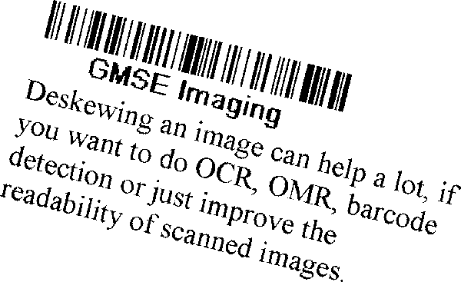
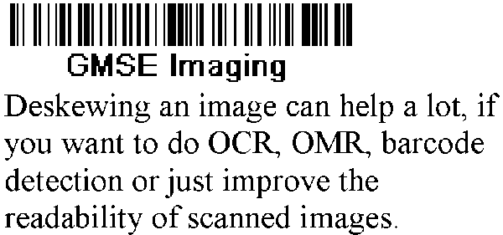
Before deskewing
After deskewing

Slide 16
Methods and Techniques used
2. Preprocessing steps:
(iv) Binarization:
Otsu's method is used to automatically perform clustering-based image thresholding [11], or the reduction of a gray level image to a binary image. The algorithm assumes that the image contains two classes of pixels following bi-modal histogram (foreground pixels and background pixels), it then calculates the optimum threshold separating the two classes so that their combined spread (intra-class variance) is minimal [12].
In Otsu's method we exhaustively search for the threshold that minimizes the intra-class variance (the variance within the class), defined as a weighted sum of variances of the two classes.

Slide 17
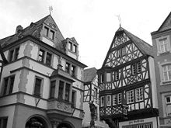
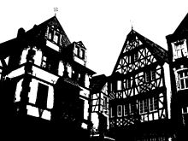
Before
After

Slide 18
Methods and Techniques used
3. The output obtained after applying the above steps is fed into Tesseract OCR engine:
We have chosen Tesseract because of widespread approbation, its extensibility and flexibility, its community of active developers.
4. The text obtained from the Tesseract engine will not be 100% error free and lexically correct (as stated in the Tesseract official documentation).

Slide 19
Methods and Techniques used
Therefore we decided to apply Post Processing Step of checking the correctness of the words lexically by implementing a spell checker and from the suggestions obtained we will choose the best suggestion provided from the spell checker service.
5. The final text obtained after applying all the above steps will be fed into TTS engine which reads aloud the text.

Slide 20
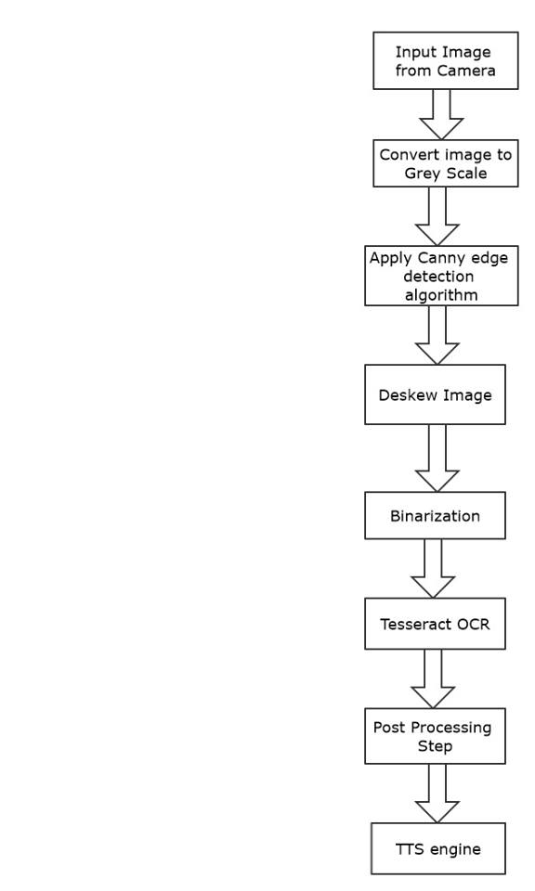
Flow chart of
our methodology

Slide 21
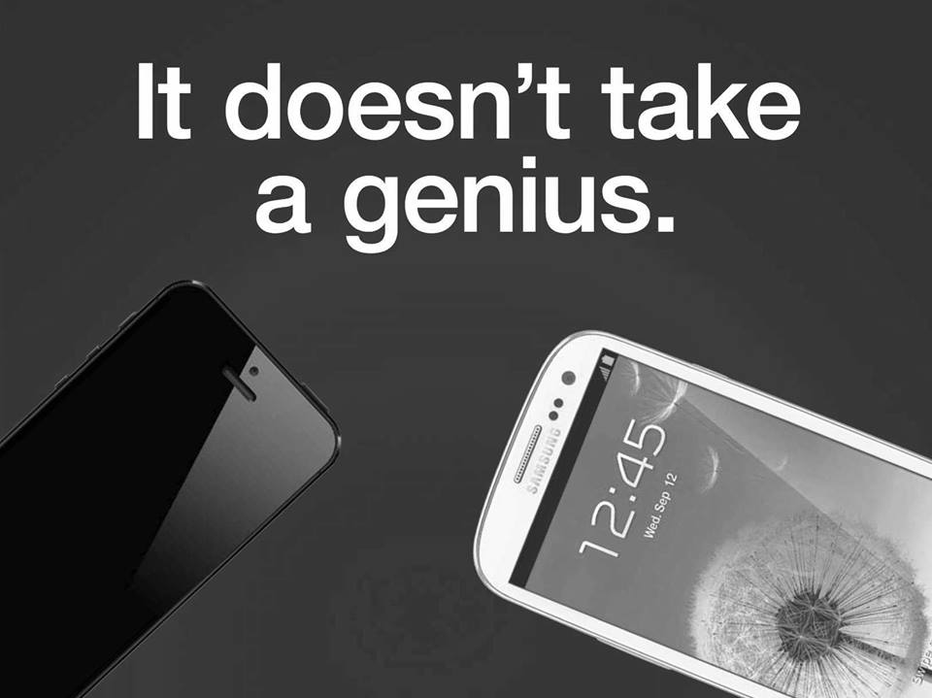
INPUT - OUTPUT
It doesnft take
a genius.

Slide 22
facebook
SoftwareEngineering

Slide 23
Motivational and Inspirational Quotes
A stone is broken by the last stroke. This does not mean that ﬁrst
stroke was useless. Success is a result of continuous daily effort.
——Unknown
Stand up, be bold, be strong. Take the whole responsibility on your own
shoulders, and know that you are the creator of your own destiny.
——Swami Vivekananda

Slide 24
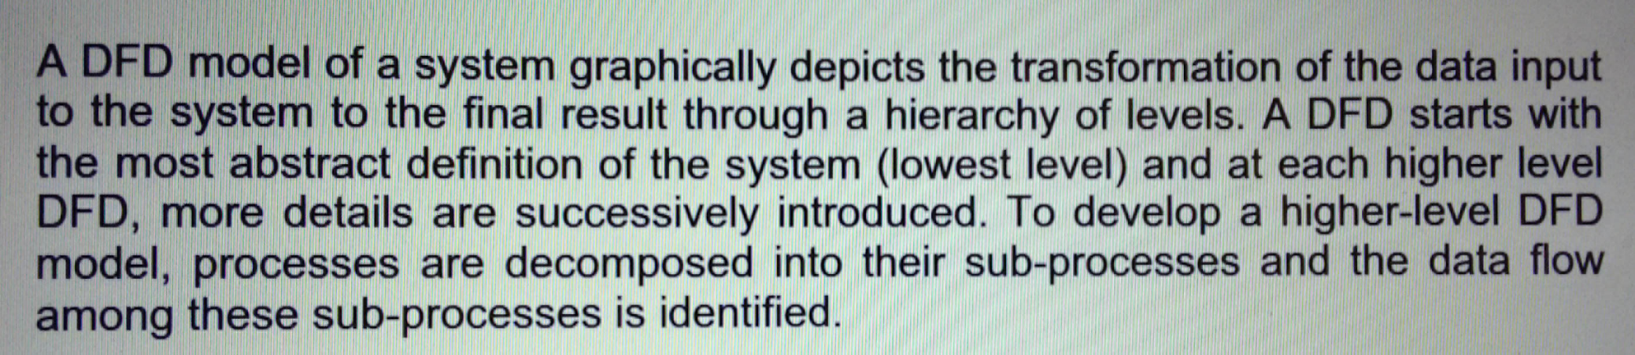
DFDﬁnwhlﬂdl‘é system graphically depicts the transformation of the data input to thesy8térhtdtheﬁ‘nal result through a hierarchy of levels. A DFD starts with the mostabst‘ract deﬁnition of the system (lowest level) and at each higher level DFD, mere details are successively introduced. To develop a higher-level DFD model, processes are decomposed into their subnprocesses and the data ﬂow among these sub—processes is identified.

Slide 25
The product is intangible The manager of a shipbuilding project or of a civil
engineering project can see the product being developed. If a schedule slips,
the effect on the product is visible—pans of the structure are obviously unﬁn-
ished. Software is intangible. It cannot be seen or touched. Software project
managers cannot see progress. They rely on others to produce the documenta—
tion needed to review progress.

Slide 26
Scope and Future plans
The scope of this project can be extended in several facets such as:
(i) Real time processing:
Instead of processing image captured, frames can be processed in real time and the text within the frames can be read aloud then and there.
(ii) Improved Binarization techniques:
Improved binarization techniques can be employed at the preprocessing stage since the main disadvantage of Otsu’s method is that they do not have an ability to exploit information of the characteristics of target images that they threshold. Other techniques like hybrid image thresholding [17] can be applied for improved results.

Slide 27
Scope and Future plans
(iii) Translation:
The application can further be developed to translate the read text to other language and convert it into audio in other language which can help tourists for reading sign boards etc.
(iv) Support for Many languages:
The application at present is confined to only English (US) but it can be further developed to support reading text of any language and then reading it aloud in any language by using translation.

Slide 28
References
[1] A. Jain and B. Yu. Automatic text location in images and video frames. In Proc. Fourteenth Intl. Conf. on Pattern Recognition, volume 2, pages 1497–1499, Aug 1998.
[2] C. W. Lee, K. Jung, and H. J. Kim. Automatic text detection and removal in video sequences. Pattern Recogn. Lett., 24:2607–2623, November 2003.
[3] H. Yan, Uniﬁed formulation of a class of image thresholding techniques, Pattern Recognition 29 (1996).
[4] J. Yang, Y. Chen, W. Hsu, Adaptive thresholding algorithm and its hardware implementation, Pattern Recognition Lett. (1994)
[5] O.D. Trier, A.K. Jain, Goal-directed evaluation of binarization methods, IEEE Trans. Pattern Anal. Mach. Intell. (1995)
[6] M. Sezgin, B. Sankur, Survey over image thresholding techniques and quantitative performance evaluation, J. Electron. Imaging 13 (1) (2004)
[7] T. M. Breuel, “The OCRopus open source OCR system,” in Proc. IS&T/SPIE 20th Annu. Symp., 2008.
[8] R. Smith, “An overview of the Tesseract OCR engine.” in ICDAR ’07 Proc. 9th Int. Conf. Document Analysis and Recognition, Curitiba, Brazil, 2007, pp. 629-633.
[9] R. Smith, D. Antonova, and D. Lee, “MOCR ’09 Adapting the Tesseract open source OCR engine for multilingual OCR,” in Proc. Int. Workshop Multilingual OCR, Barcelona, 2009.

Slide 29
References
[10] Optical Character Recognition –Ravina Mithe, Supriya Indalkar, Nilam Divekar. International Journal of Recent Technology and Engineering (IJRTE) ISSN: 2277-3878, Volume-2, Issue-1, March 2013
[11] M. Sezgin and B. Sankur (2004). "Survey over image thresholding techniques and quantitative performance evaluation". Journal of Electronic Imaging
[12] Nobuyuki Otsu (1979). "A threshold selection method from gray-level histograms". IEEE Trans. Sys., Man., Cyber.
[13] http://en.wikipedia.org/wiki/Otsu's_method
[14] http://docs.opencv.org/trunk/doc/py_tutorials/py_imgproc/py_canny/py_canny.html
[15] Tesseract OCR Engine, Ray Smith, Google Inc OSCON 2007
[16] http://www.codeproject.com/Articles/13615/How-to-deskew-an-image
[17] Hybrid Image Thresholding Method using Edge Detection by Febriliyan Samopa and Akira Asano, Department of Information Engineering, Graduate School of Engineering, Hiroshima University, Higashi-Hiroshima, Hiroshima, Japan.

Slide 30
Thank you ☺

